Slide 1

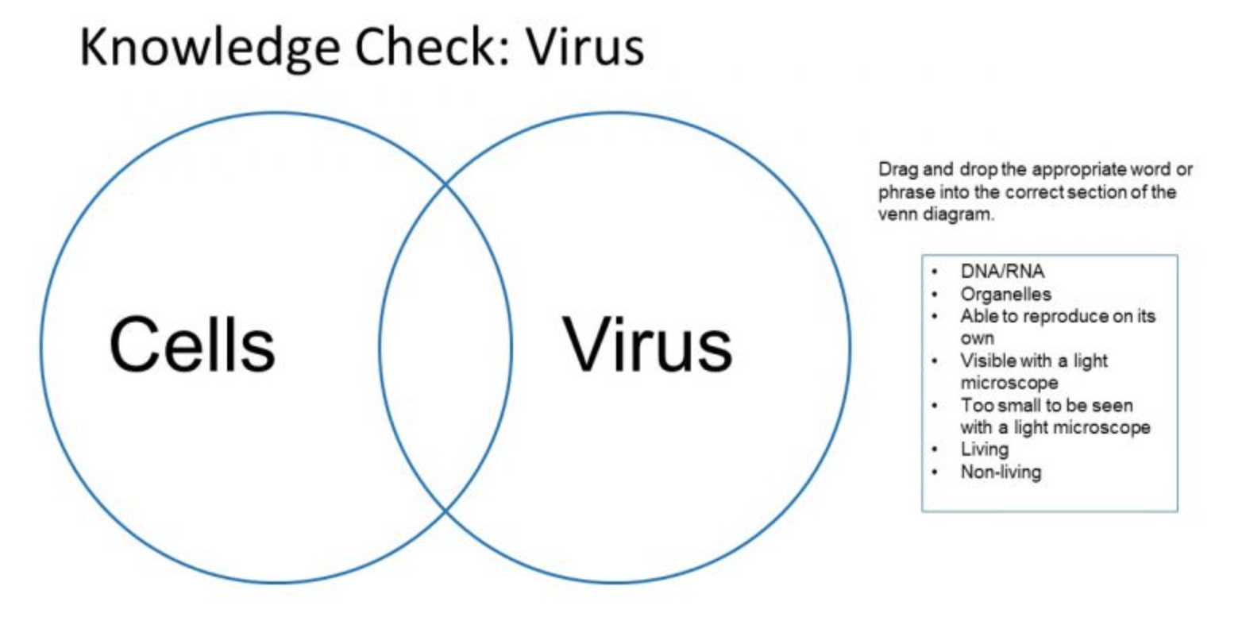
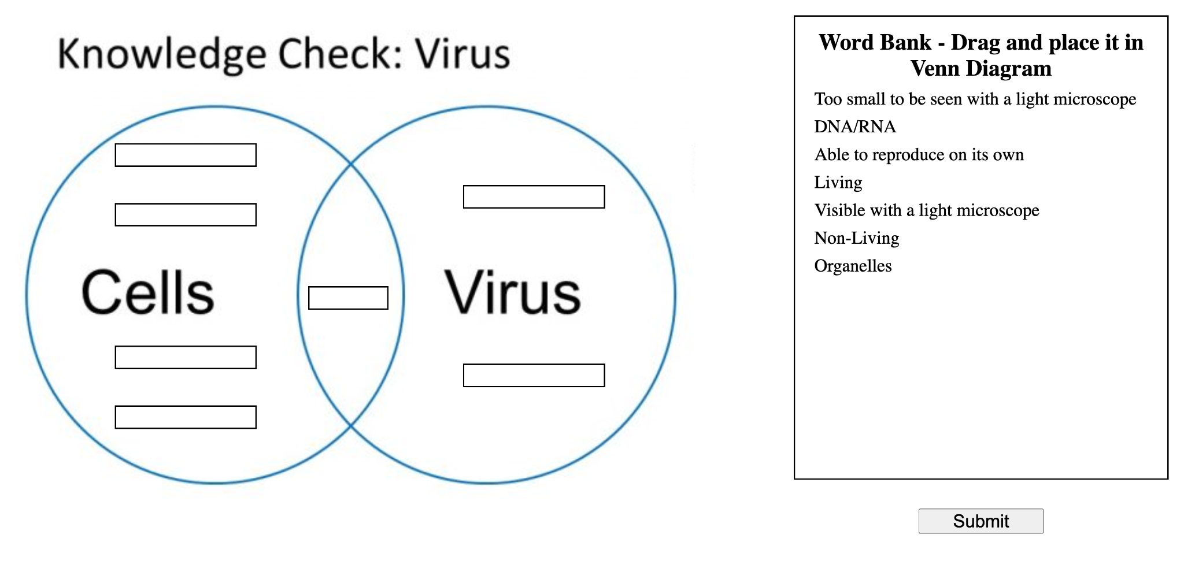
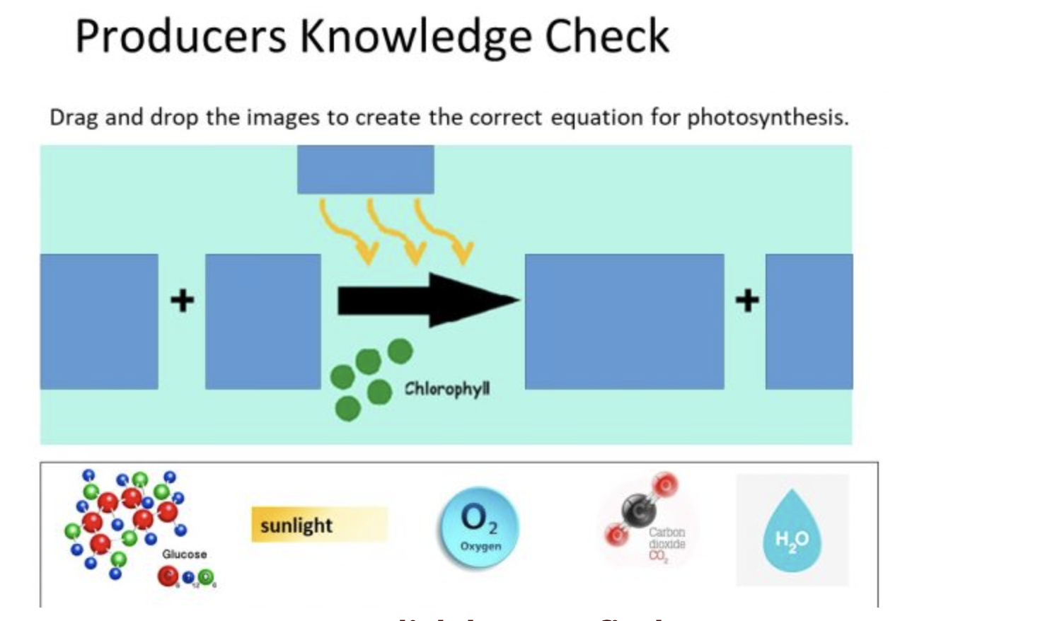
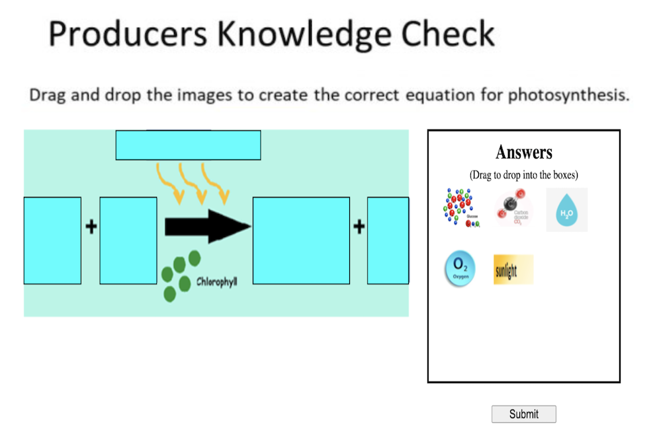
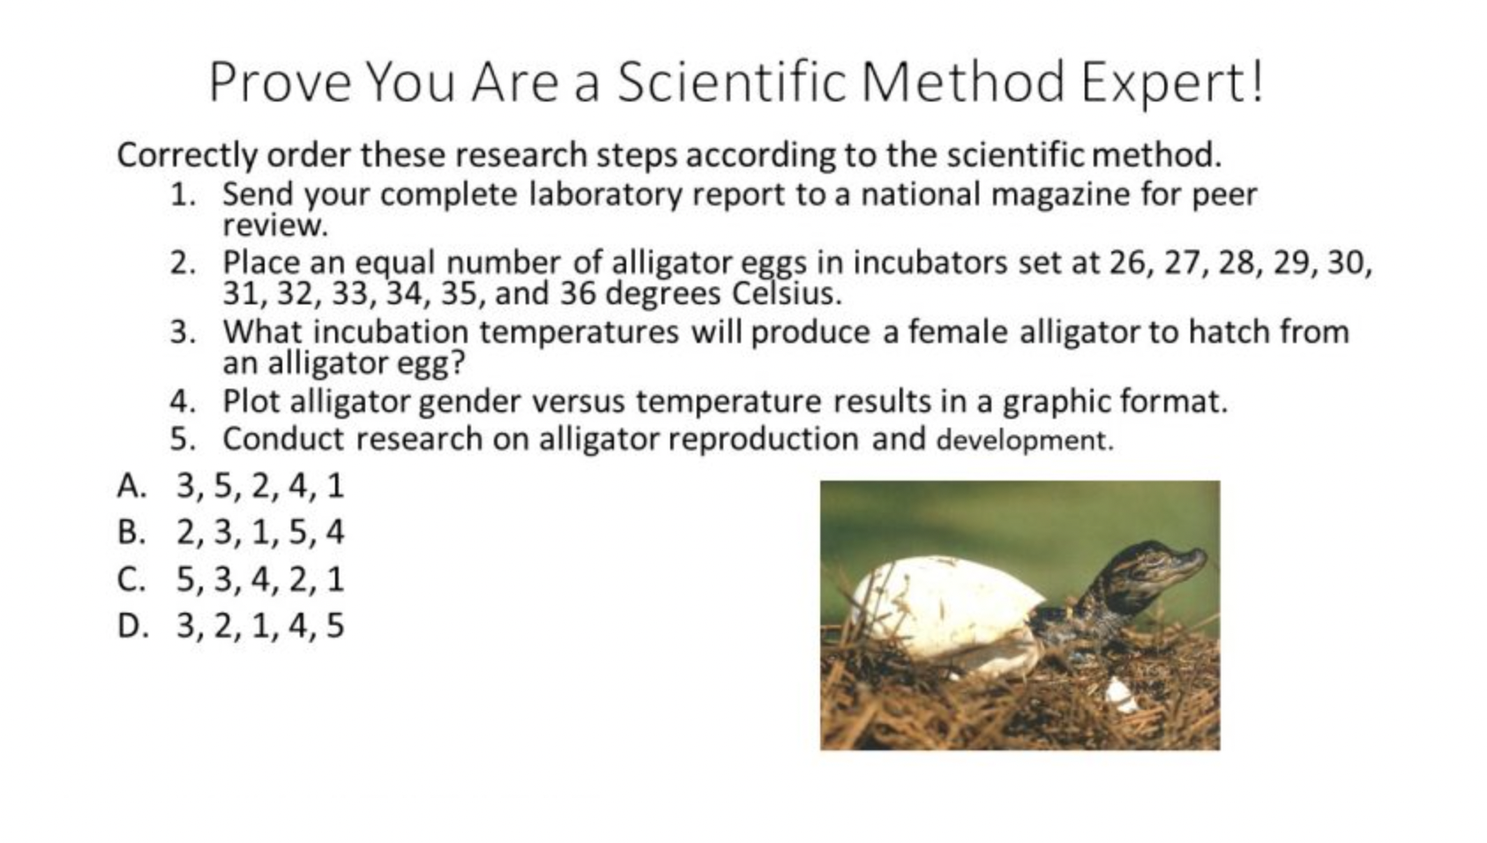
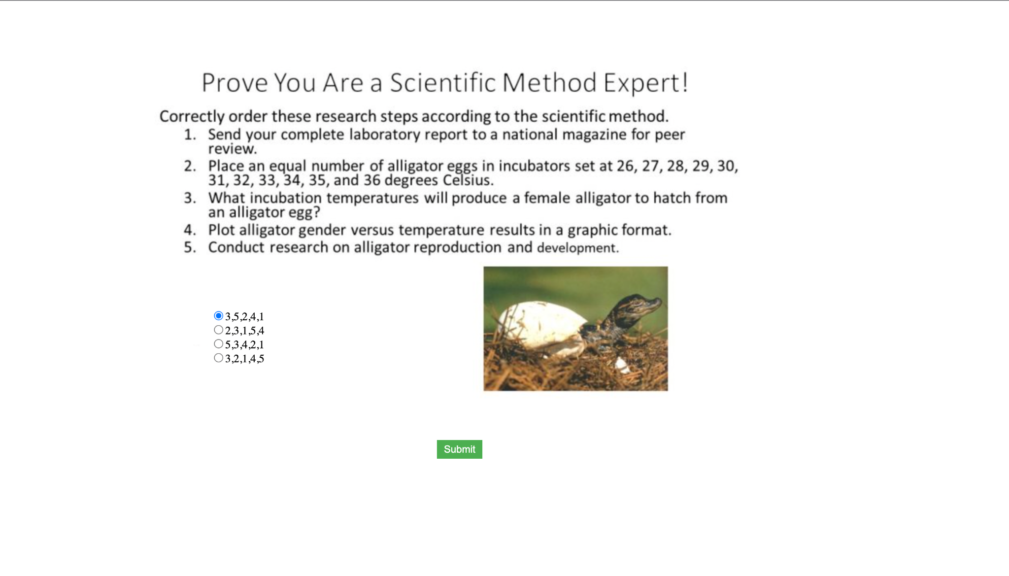
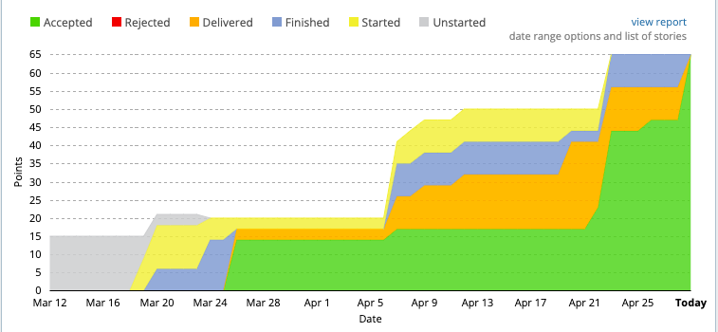
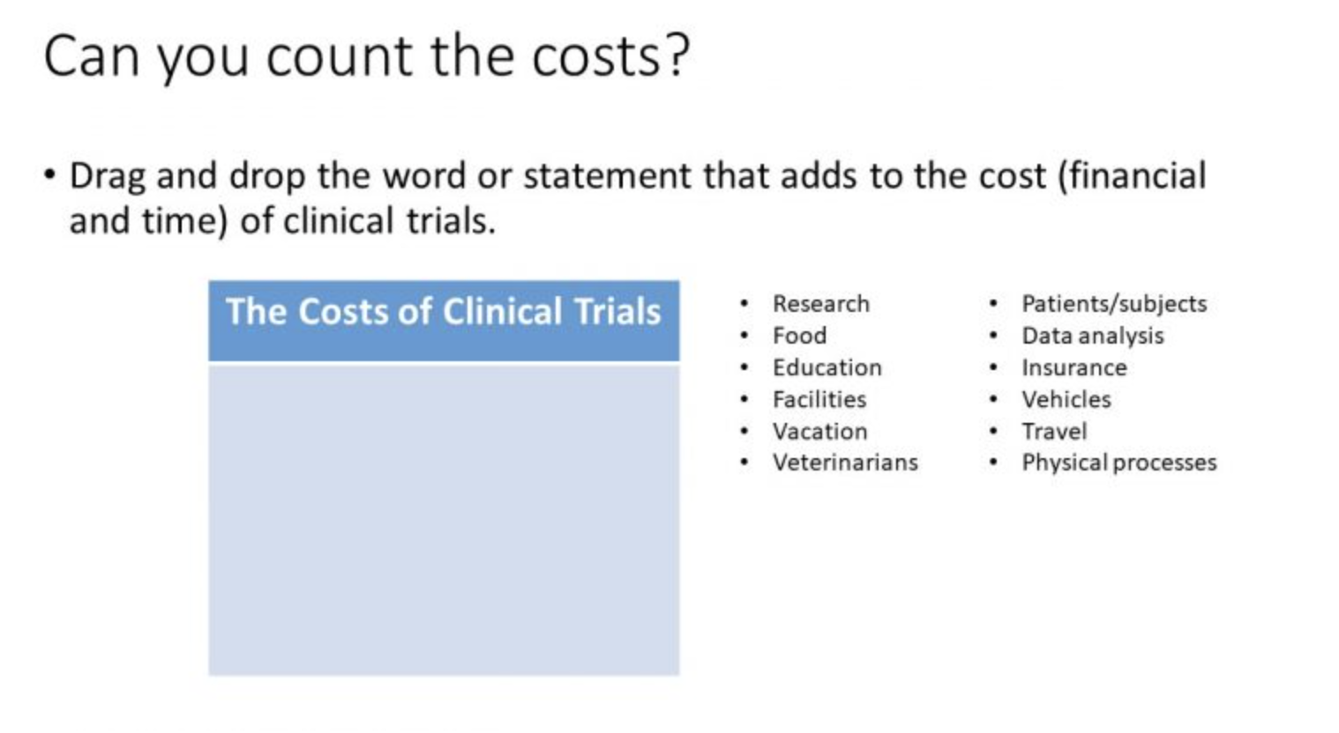
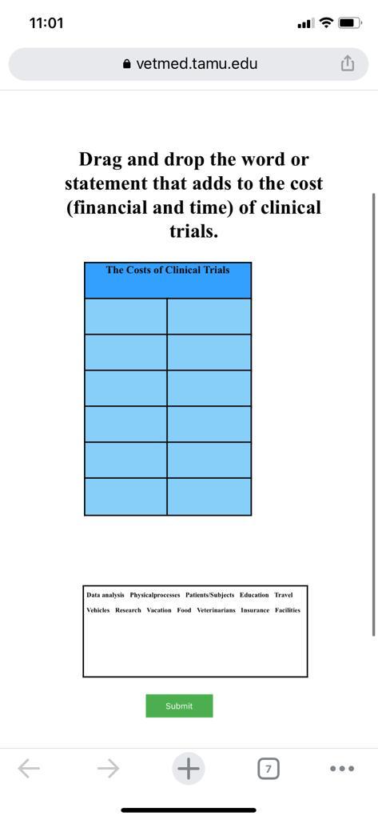
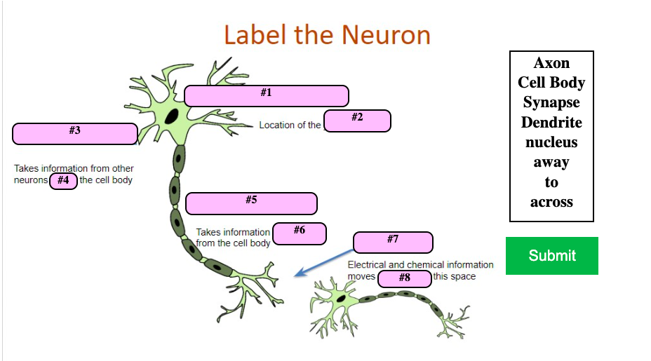
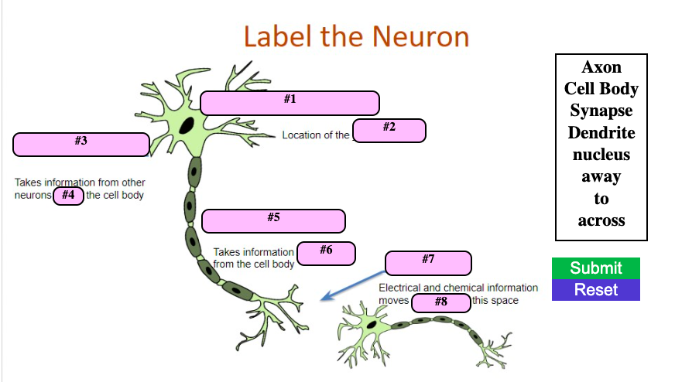
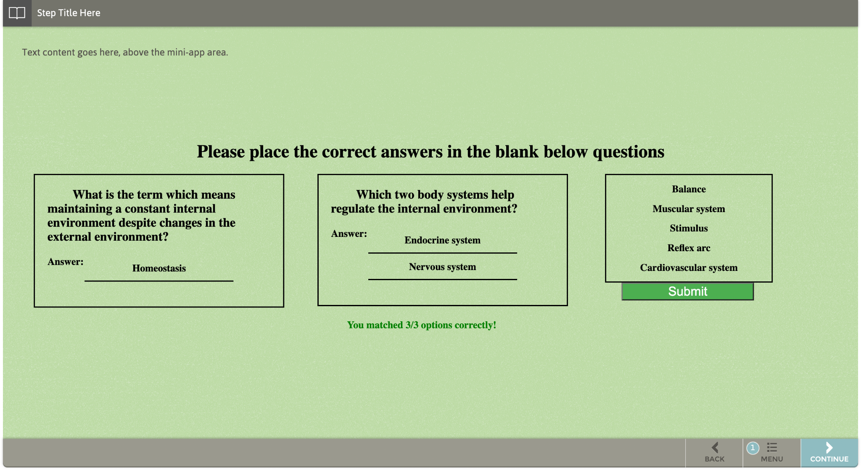
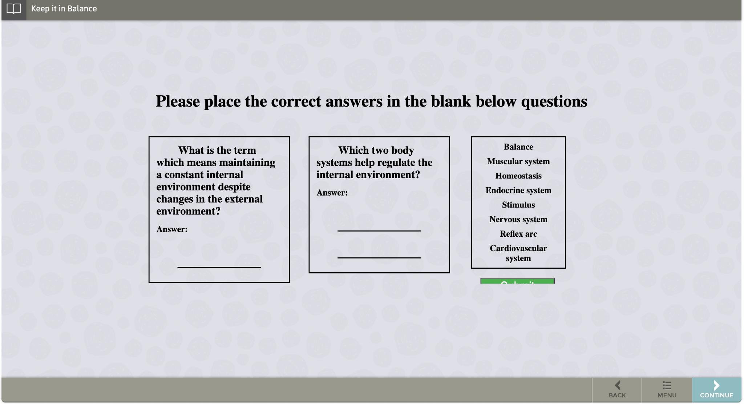
Vetmed Biology Learning Games and Animations
Apurva Purushotama, FNU Nimisha, Prajwal Das, Sai Harini Voruganti, Shubham Gupta
Department of Computer Science and Engineering, Texas A&M University
Introduction
Animation slides
Target customer: VetMed TAMU, Dr. Hank Walker
Goal: Aid middle school children to learn biological concepts through interactive games and animations.
Requirement: Developed and enhanced JS/JQuery/HTML/CSS applications exposed through an existing platform called ‘StepStone’ and a WordPress based website.
Developed new drag and drop animations for the modules. The left figure below is the non interactive version and the right figure shows the version we developed.
Agile Workflow
ITERATION 0
ITERATION 1
Gathering requirements, preparing inventory sheet.
Reading documentations.
Understanding legacy code
Familiarizing JS, JQuery, HTML & CSS
Verifying previous deployments on StepStone and WordPress.
Developing and testing 4 drag and drop animations.
Planning deployment schedule.
Created new animations for the modules. The left figure below shows the non interactive version of the slide. The animation developed allows the user to drag and drop the image to form the right equation.
ITERATION 2
ITERATION 3
FINAL
Developing and testing 5 drag & drop animations.
Ensuring all developments are compatible on mobile devices.
Parameterizing the code.
Understanding the requirements for StepStone deployment.
Ensuring all the developed slides are deployed on wordpress and StepStone.
Generating velocity graph
Created new radio button animations for the modules. The left image below shows a comparison of the previous version with the latest version with our changes.
Developed the drag and drop animations. Ensured that the animations are compatible with mobile devices. The right image is the mobile view for the same.
Most of the animations developed were deployed to StepStone and WordPress environments after Iteration 3. Hence, in the above velocity graph, it can be seen that most points were accepted after Iteration 3.
Deployment Snapshots
Improved the UX of the application by adding a Reset button. Figure below shows a comparison between previous and modified version.
.
Fixed the existing drag and drop portion and submit button functionality to verify the correct answers. Ensured that prompts indicating the number of correct answers works for partially filled inputs.
Goals Achieved / Impact
Acknowledgements
We successfully reached our desired goal, which was to develop interactive animations for various modules under OneHealth.
The animations were deployed on Stepstone and Wordpress for students to have a fun learning experience in understanding biology concepts.
The colors,images,font sizes for the animations were chosen keeping accessibility in mind.
The existing animations have also been made compatible for mobile devices and have been thoroughly tested on Stepstone and Wordpress.
Ensured customer feedback was incorporated in each iteration to achieve the desired goal.
We would like to thank Dr. Hank Walker, our instructor Dr. Philip Ritchey and TAs Abhishek Sinha and Akshit Kharbanda for their help in verifying our progress and providing inputs and feedback throughout the course of the project. We further extend our gratitude towards Daniel Shuta and Samiksha Marne for helping us understand the deployment process and making the developed animations reach the students by deploying them in Stepstone and Wordpress environments in a timely manner.

